Slide 1
Robots – Theory
Ohm Law

Slide 2
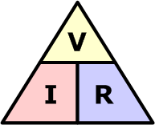
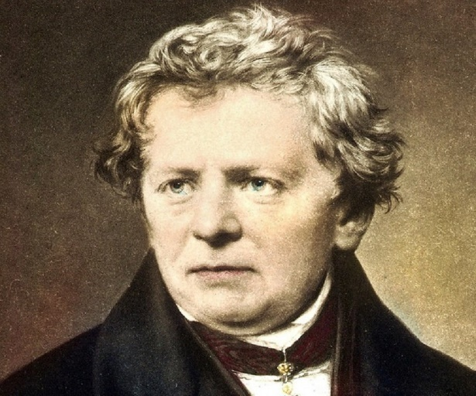
Ohms Law and Power
The relationship between Voltage, Current and Resistance in any DC electrical circuit was firstly discovered by the German physicist Georg Ohm.

Slide 3
Introduction – Ohm´s Law
Ohm's Law is the most fundamental law of electrical circuits and give a relationship between voltage and current in an ideal conductor. This relationship states that:
The potential difference (voltage) across an ideal conductor is proportional to the current through it.
The constant of proportionality is called the "resistance", R.
Ohm's Law is given by:
U = I R

Slide 4
Ohm´s Law
Material that obeys Ohm's Law is called "ohmic" or "linear" because the potential difference across it varies linearly with the current.
Ohm's Law can be used to solve simple circuits. A complete circuit is one which is a closed loop. It contains at least one voltage source and at least one potential drop the algebraic sum of the voltages around a complete close loop (called also mesh) is zero.

Slide 5
Ohm´s Law
A constant temperature, the electrical current flowing through a fixed linear resistance is directly proportional to the voltage applied across it, and also inversely proportional to the resistance. This relationship between the Voltage, Current and Resistance forms the basis of Ohms Law and is shown below.

Slide 6
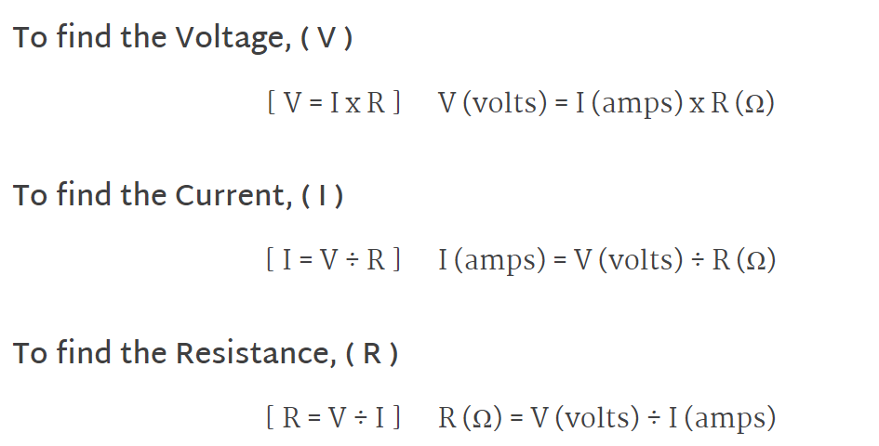
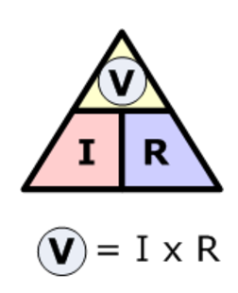
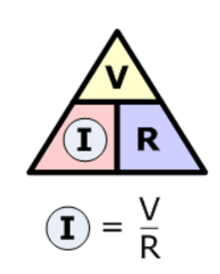
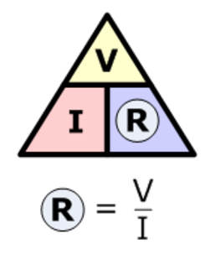
Ohm´s Law

Slide 7
Ohm´s Law Electrical Power in Circuits
Electrical Power, ( P ) in a circuit is the rate at which energy is absorbed or produced within a circuit. A source of energy such as a voltage will produce or deliver power while the connected load absorbs it.

Slide 8
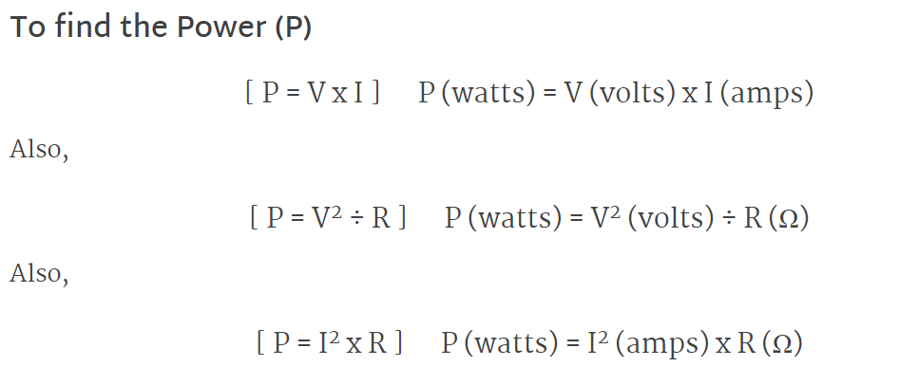
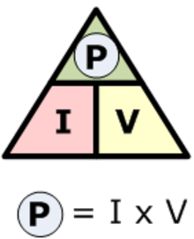
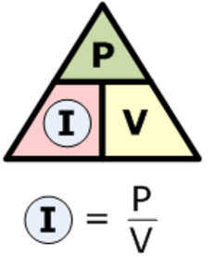
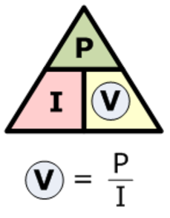
Ohm´s Law Electrical Power in Circuits
The quantity symbol for power is P and is the product of voltage multiplied by the current with the unit of measurement being the Watt ( W ).

